Slide 1


Insights of the Analysis

Slide 2


Today's agenda
Project recap
Problem
The Analytics team
Process
Insights
Summary

Slide 3

Social Buzz, a rapidly expanding tech actor, must swiftly adjust to its global scale.
To support this, Accenture has initiated a three-month proof of concept (POC) that includes:
Auditing Social Buzz’s big data practices
Providing recommendations for a successful IPO
Analyzing to identify Social Buzz’s top 5 most popular content categories
Project Recap

Slide 4


Problem
With over 100,000 daily posts, and 35.5 million pieces of content annually
How to capitalize effectively on such a vast volume of content?

Slide 5



Andrew Fleming
(Chief Technical Architect)
The Analytics team
Marcus Rompton
(Senior Principle)
Youcef Belkhiri
(Data Analyst)

Slide 6
Process
1
Data Understanding
2
Data Cleaning
3
Data Modeling
4
Data Analysis
5
Uncover Insights

Slide 7
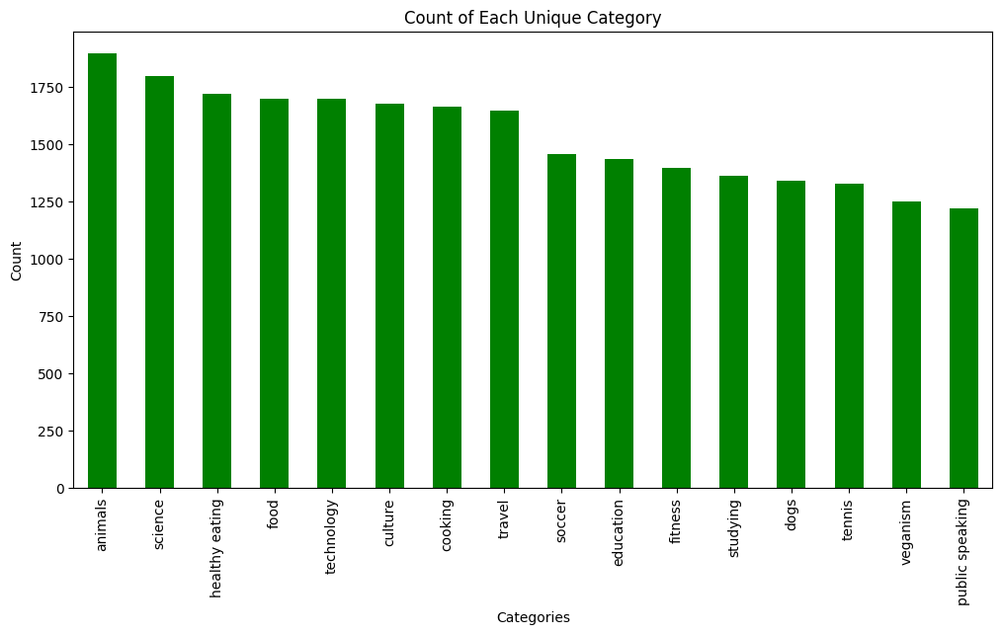

Insights
Number of unique categories: 16

Slide 8
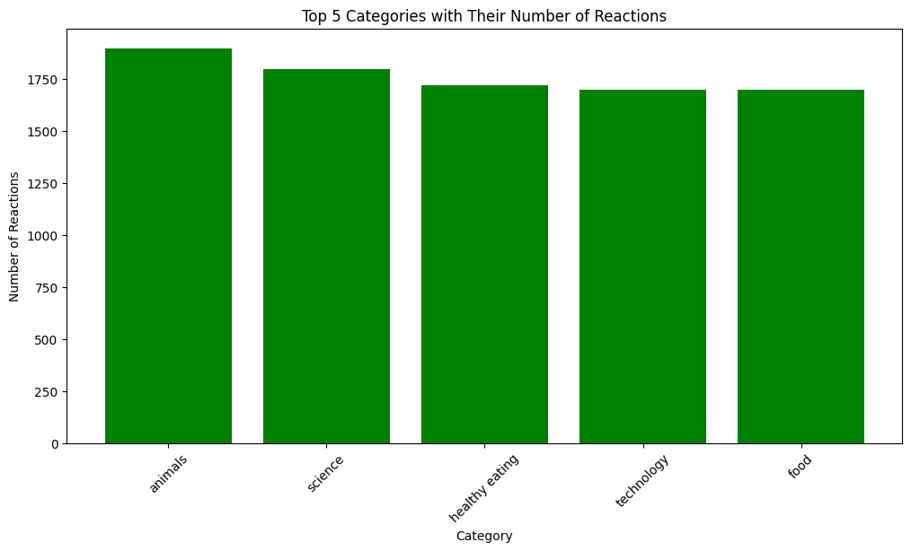
How many reactions are there to the most popular category?
● 1897 reactions

Slide 9
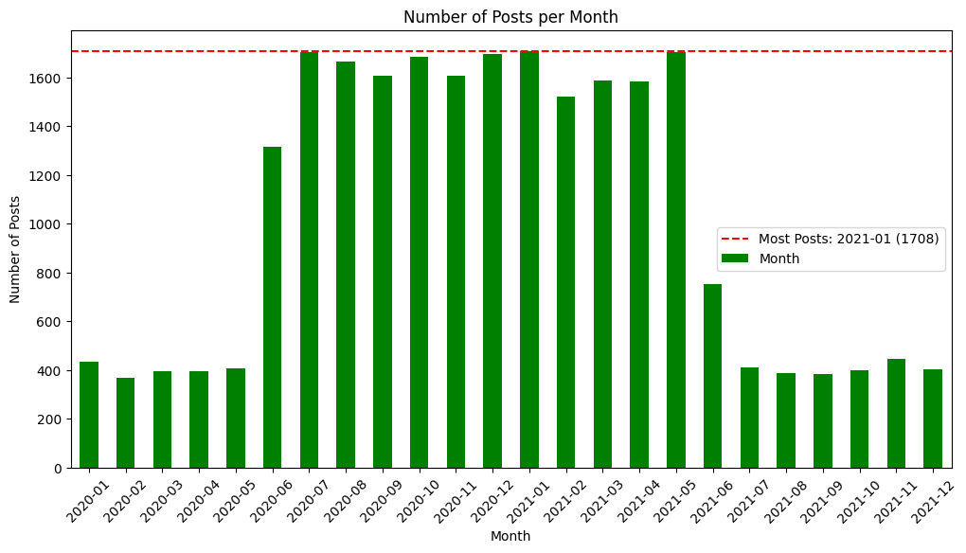
What was the month with the most posts?
● Jan 2021 (1708 posts)

Slide 10

Our analysis highlights the top 5 content categories by reaction count, showcasing the most engaging topics for your audience.
Additionally, we identified monthly posting trends, with a clear peak in activity, which can inform your future content planning and engagement strategies. These insights are crucial for optimizing Social Buzz’s content to better meet audience preferences and maximize engagement.
Summary

Slide 11

Thank you!
ANY QUESTIONS?

